Slide 1



Welcome to My Presentation
Topic: Psychological Effects of Internet Trolling & Harassment
Presented by
Name : Naznin Nahar Munni
TID: B021018
Batch: 21
Computer Fundamental and Office Application

Slide 2
Introduction
Internet trolls can be annoying and frustrating, but it can also be harmful to our mental health if we let them affect us. Studies have shown that exposure to online harassment can lead to stress, anxiety, depression, low self-esteem, and even suicidal thoughts.
1. What is Internet Trolling?
Deliberately posting inflammatory comments to provoke others.
2. What is Online Harassment?
Repeated, targeted abuse or intimidation via digital platforms.

Slide 3
Overview of the Problem
Statistics
59% of U.S. adults have experienced online harassment. (Source: Pew Research Center)
10% of teens report severe online harassment. (Source: Cyberbullying Research Center)
Examples
Case studies or headlines about prominent trolling incidents.

Slide 4
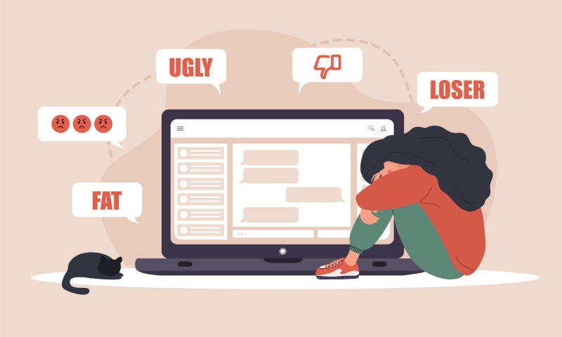
Emotional Impact

Slide 5
1. Anxiety and Depression
Victims may experience increased anxiety and depression.
2. Stress Responses
Chronic stress and its effects on mental health.
3. Self-Esteem Issues
Damage to self-worth and self-image.

Slide 6

Behavioral Changes
Changes in Online Behavior
Increased privacy settings or account deactivation.
Withdrawal from Social Interaction
Decreased online and offline social activities.
Disturbing sleeping
Shift in social norm

Slide 7
Long-Term Effects
1. PTSTD
Flashbacks
Nightmares
Difficulty in concentration
2. Overall Life Satisfaction
Impact on quality of life and daily functioning.
Self harm & suicidal thoughts

Slide 8

Impact on Professional Relationships
1. Workplace Stress
Difficulty focusing or performing at work.
2. Career Implications
Potential for career-related stress and isolation.

Slide 9
Broader Social Implications
1. Community Impact
How trolling affects the overall health of online communities.
2. Discourse and Engagement
Reduced willingness to participate in online discussions.

Slide 10
Preventive Measures for Individuals
1. Self-Care Practices
Techniques for managing stress and anxiety.
Seek help from a psychologist.
2. Setting Boundaries
Tips for protecting oneself online (e.g., privacy settings).

Slide 11
Community and Platform Responses
1. Role of Social Media Platforms
Overview of tools and policies for reporting abuse.
2. Community Initiatives
Programs or support groups aimed at combating online harassment.

Slide 12
Policy and Legal Measures
1. Current Laws and Regulations
Overview of existing legal protections against online harassment.
2. Recommendations for Improvement
Suggestions for policy changes to better address trolling and harassment.

Slide 13
Conclusion
1. Summary of Key Points
Recap of the psychological impact and necessary responses.
2. Call to Action
Encouraging proactive measures and support for affected individuals.

Slide 14


